Slide 1

Creating cortical models across scales in NeuroML
Open Source Brain workshop 2019
11th Sept 2019
Padraig Gleeson
p.gleeson@ucl.ac.uk
University College London
http://www.opensourcebrain.org
Notes:
8/17/17
1
1

Slide 2
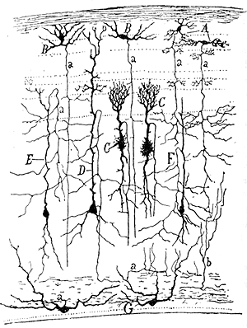
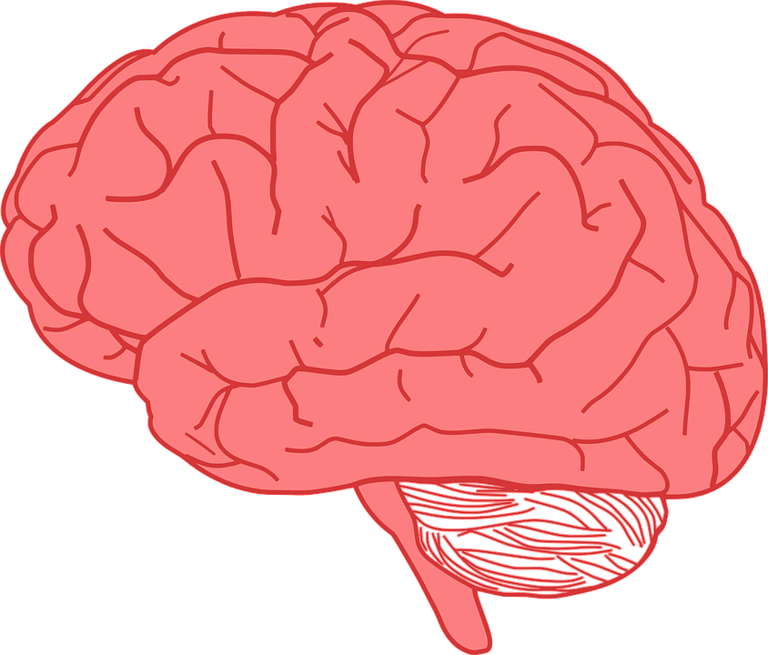
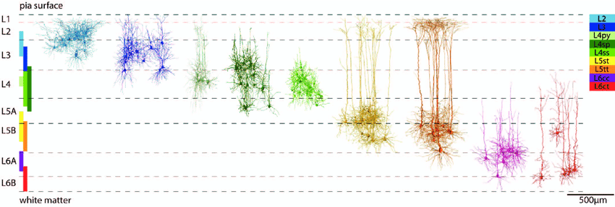
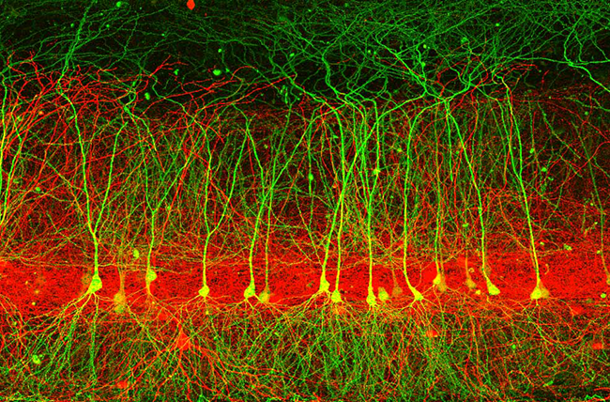

Slide 3
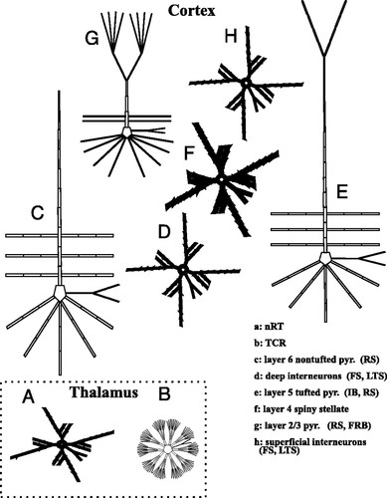
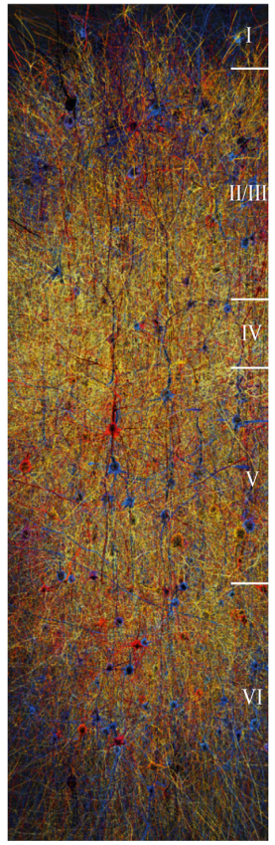
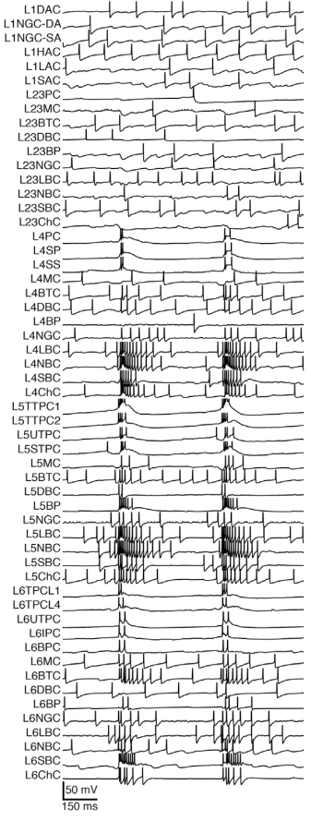
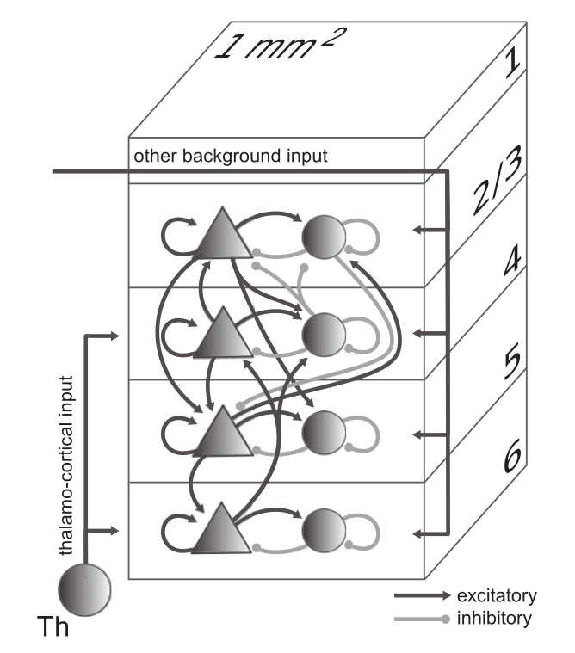
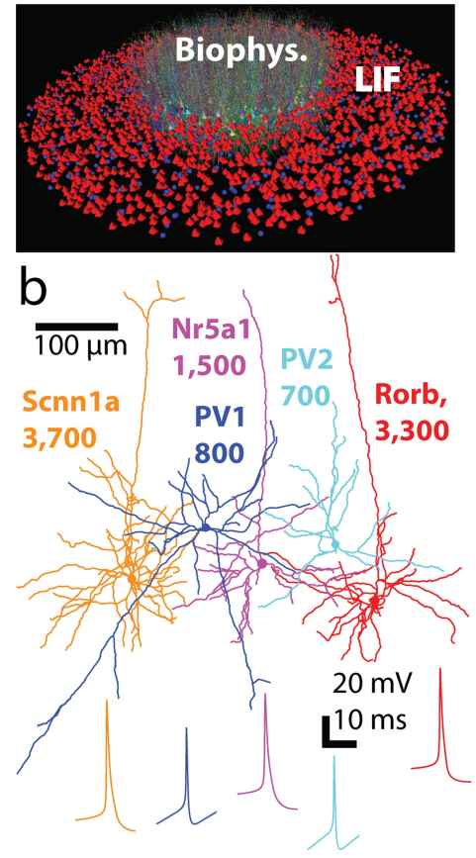
Markram et al. Cell 2015
Traub et al., J. Neurophysiol. 2005
Potjans & Diesmann,
Cereb. Cortex 2014
Arkhipov et al. PLoS CB 2018

Slide 4
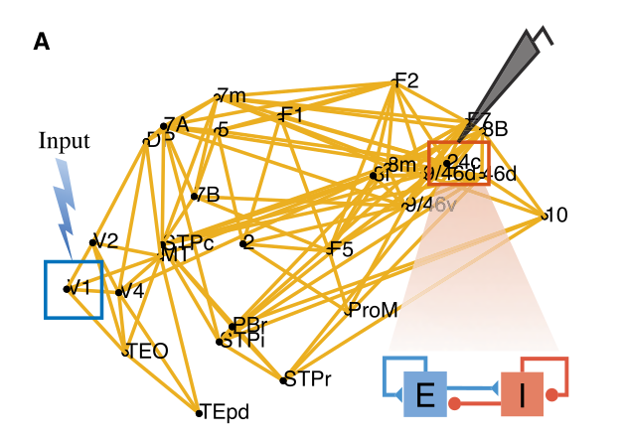
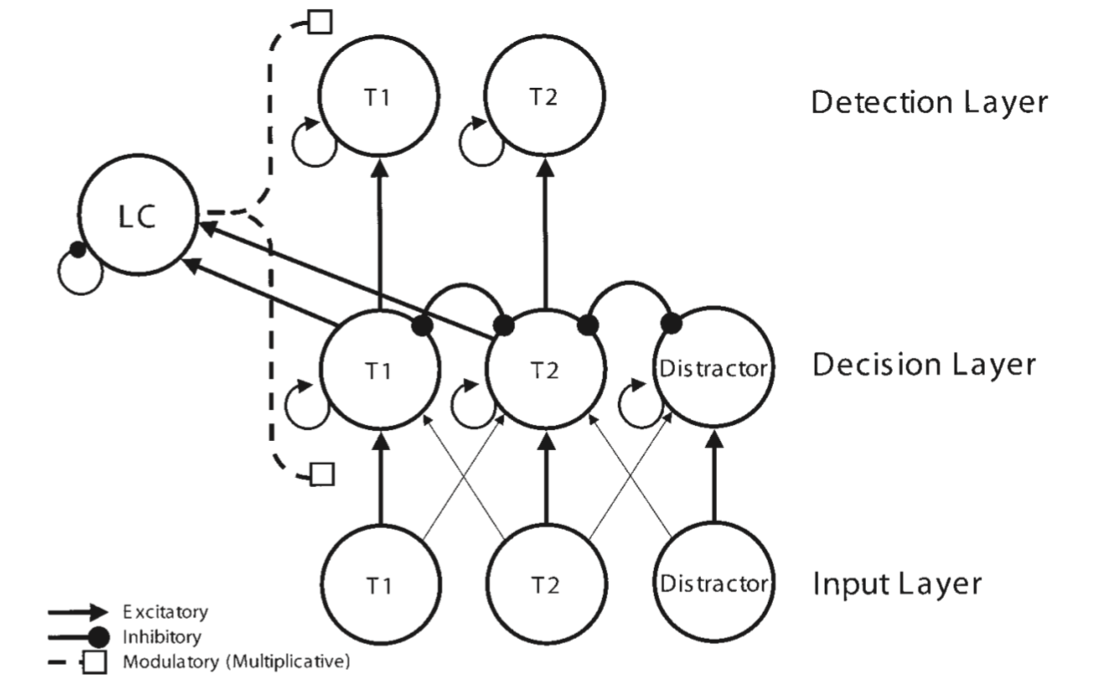
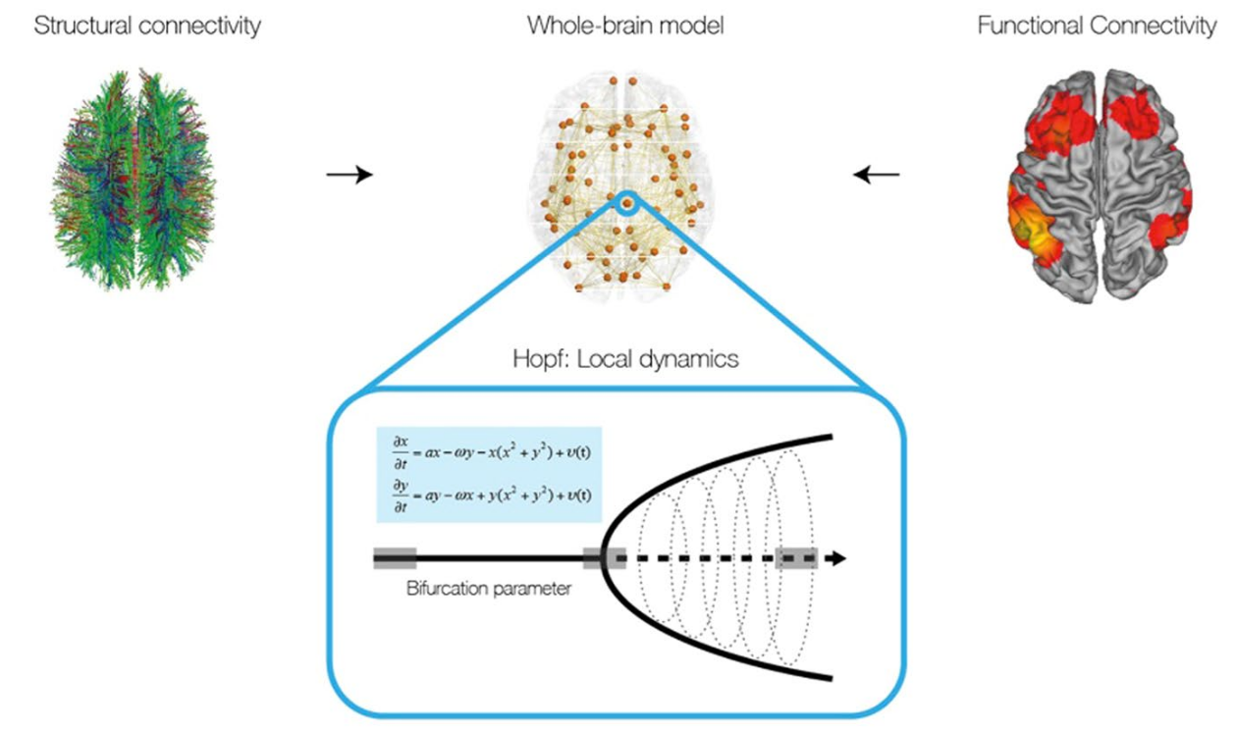
Inter-areal Balanced Amplification Enhances Signal
Propagation in a Large-Scale Circuit Model of the
Primate Cortex, Joglekar et al., Neuron 2018
The Role of the Locus Coeruleus in Mediating the Attentional Blink: A Neurocomputational Theory, Nieuwenhuis et al. Journal of Experimental Psychology, 2005
The dynamics of resting fluctuations in the brain: metastability and its dynamical cortical core, Deco et al. Scientific Reports 2017

Slide 5
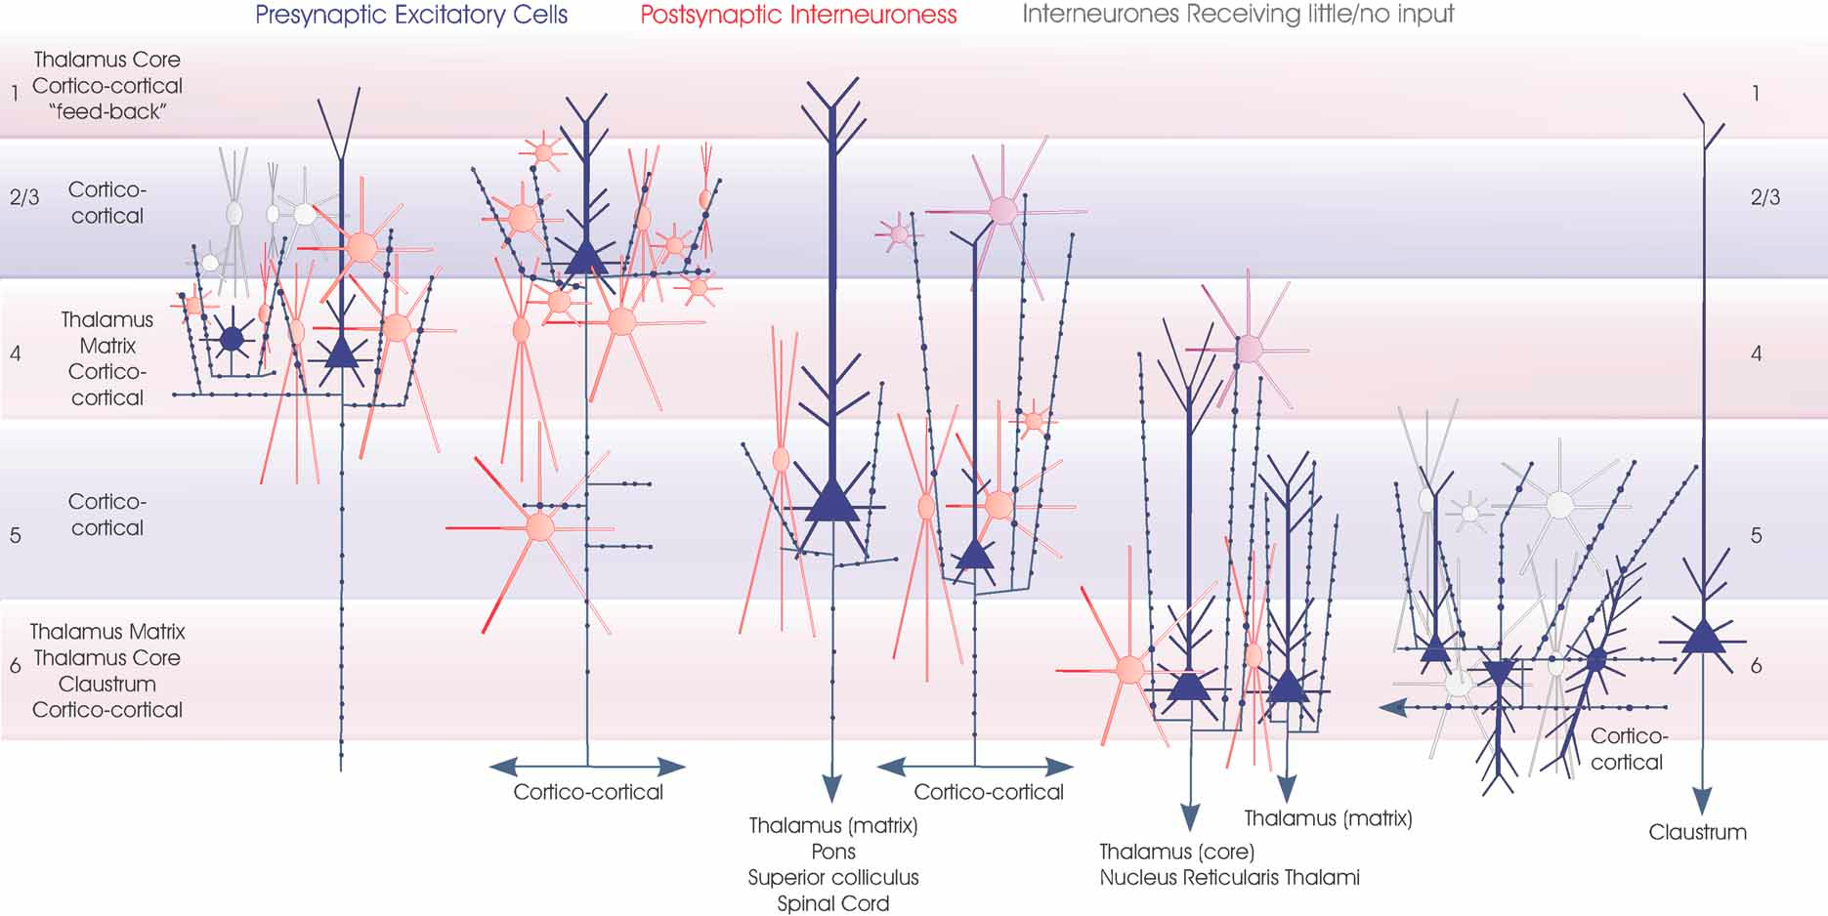
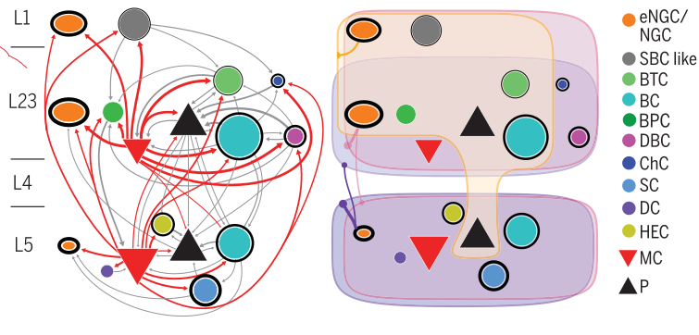
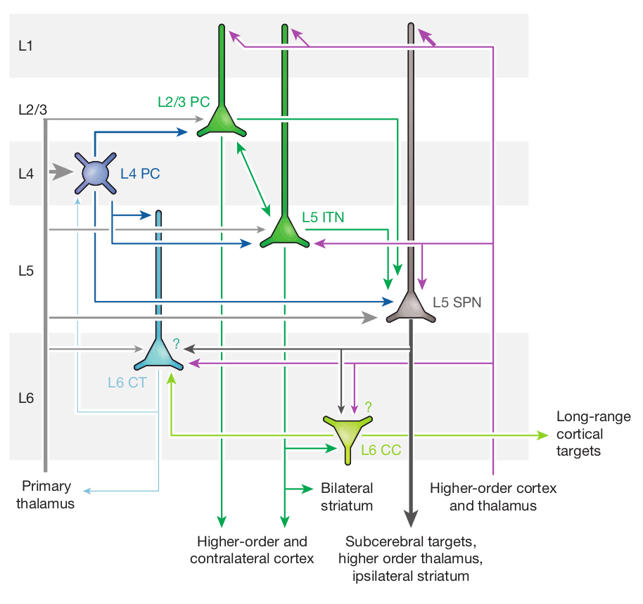
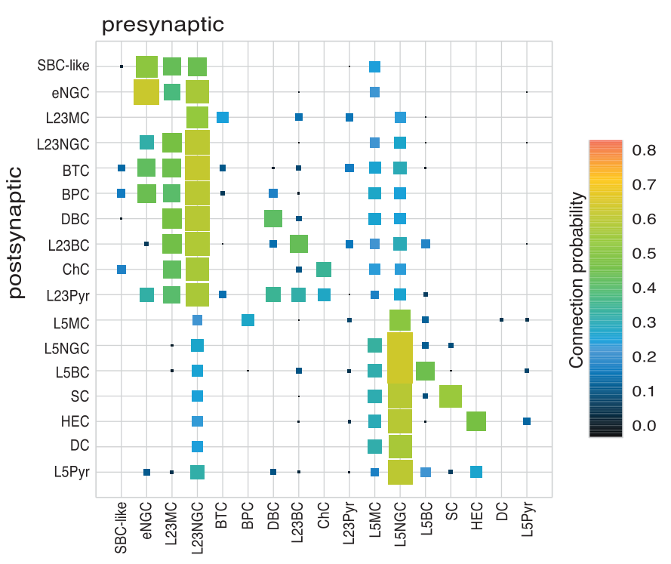
Functional maps of neocortical local circuitry, Thomson & Lamy, Front. Neurosci. 2007
Principles of connectivity among morphologically defined cell types in adult neocortex, Jiang et al. Science 2015
Cortical connectivity and sensory coding, Harris & Mrsic-Flogel, Nature 2013

Slide 6
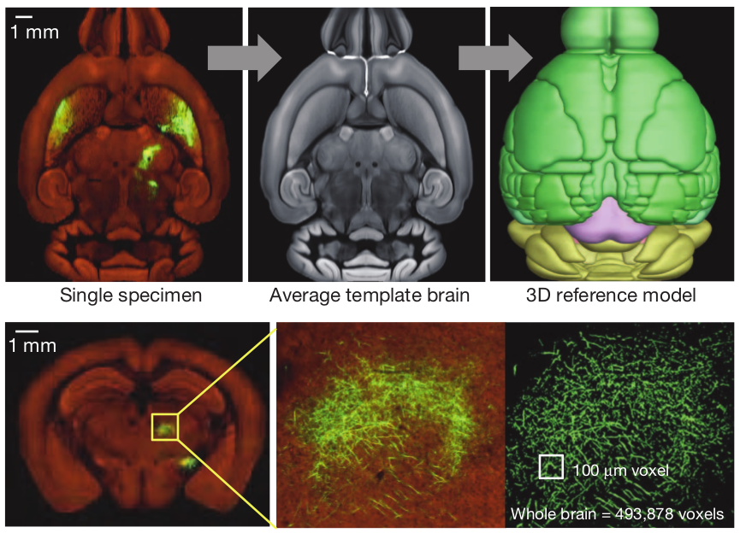
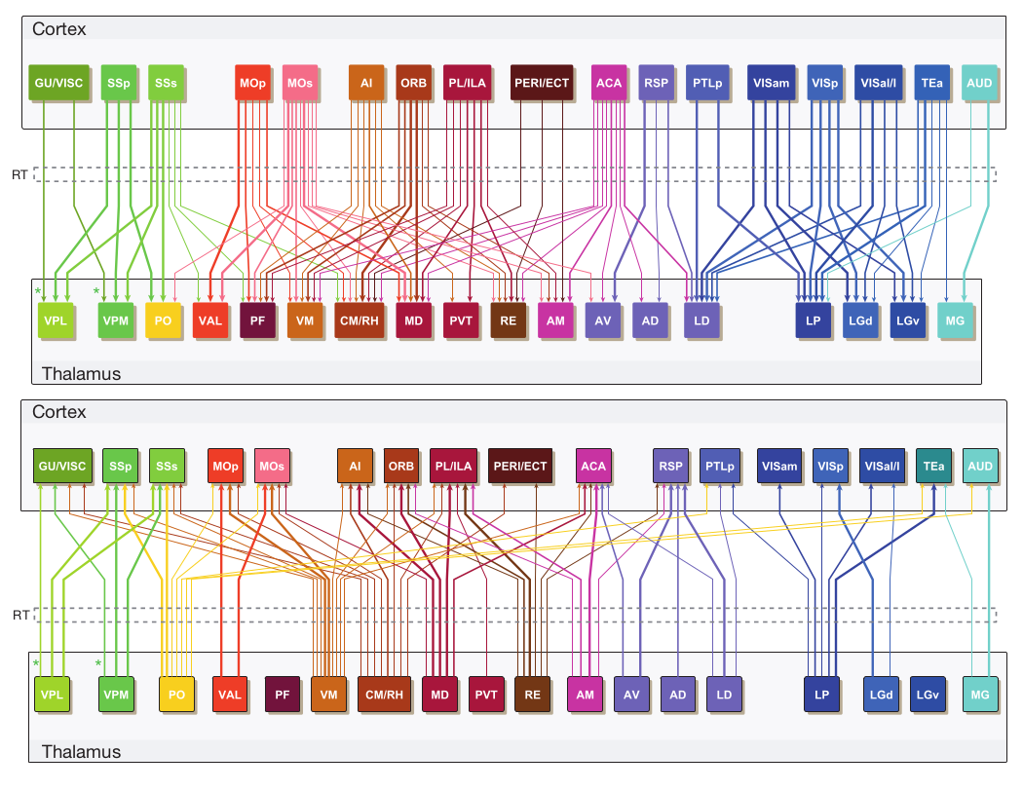
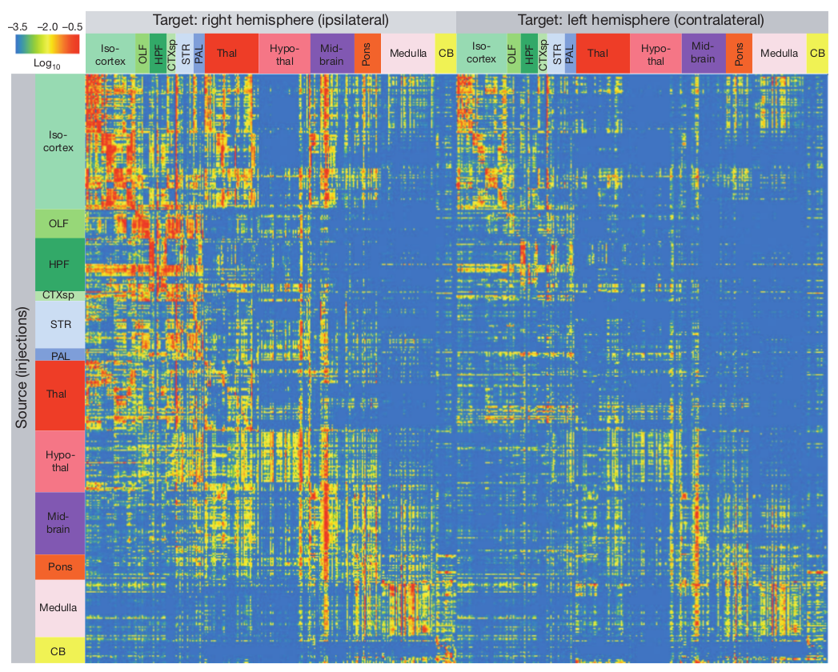
A mesoscale connectome of the mouse brain, Oh et al.
Nature 2014

Slide 7
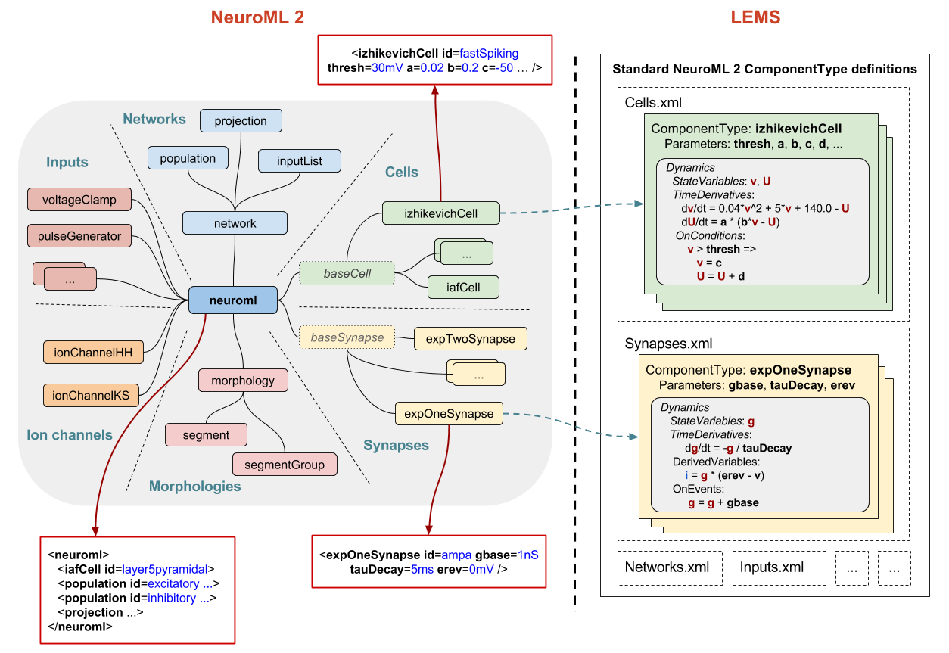
http://www.opensourcebrain.org
Notes:
8/17/17
7
7

Slide 8
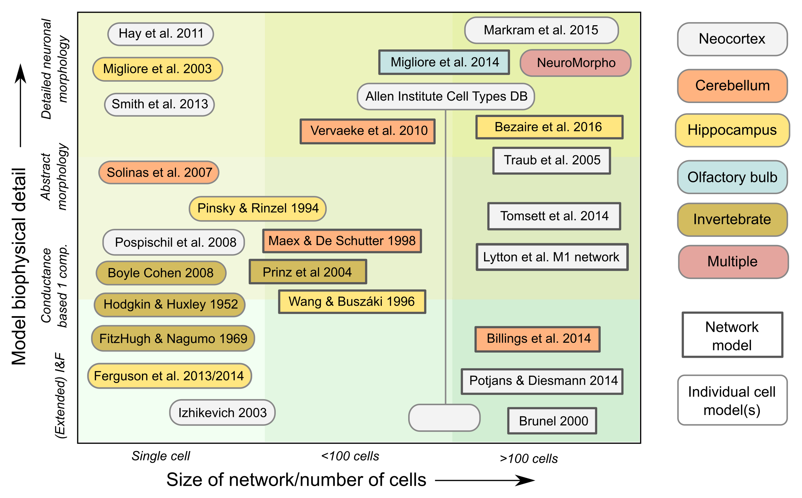
Notes:
8/17/17
8
8

Slide 9
Extending NeuroML
NeuroML geared towards (spiking) neuron networks
Need an extensible representation of populations & projections
Can be used for both models and experimental data
-> NeuroMLlite
http://www.opensourcebrain.org
Notes:
8/17/17
9
9

Slide 10
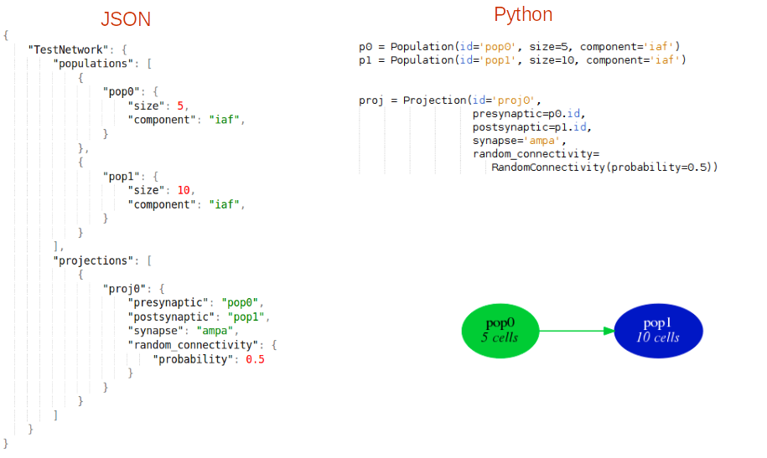
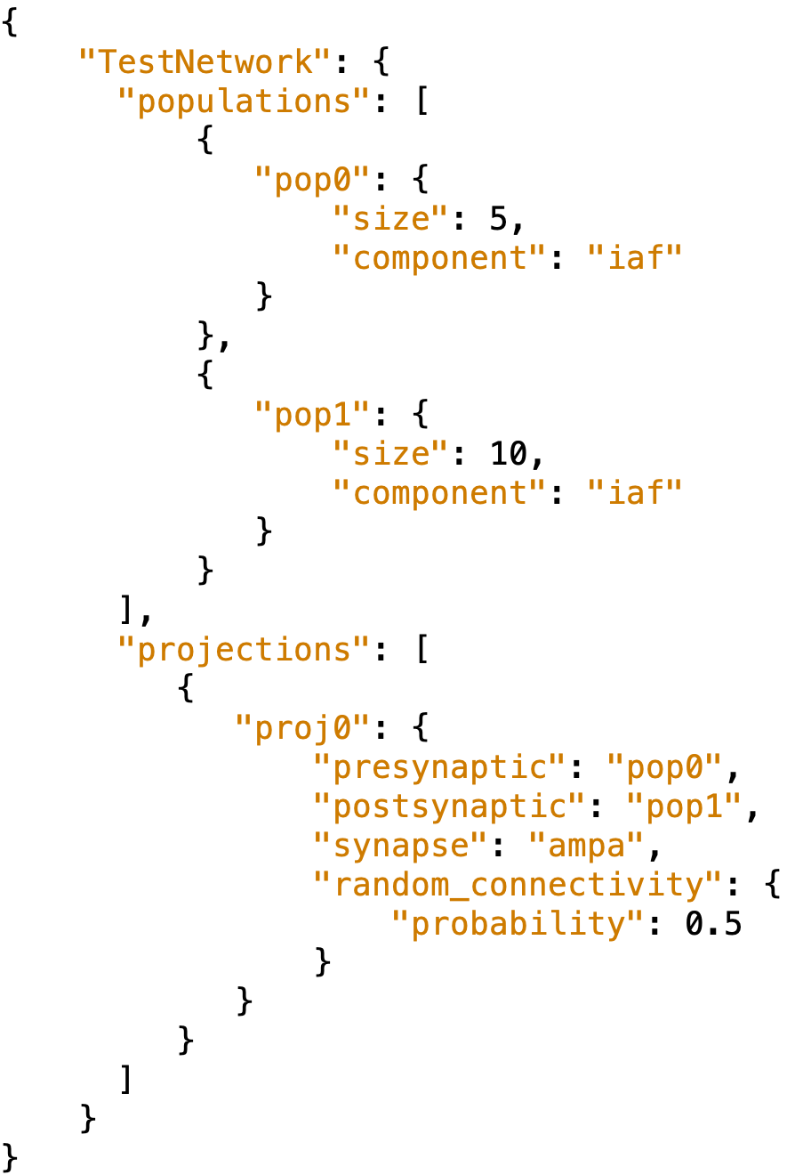
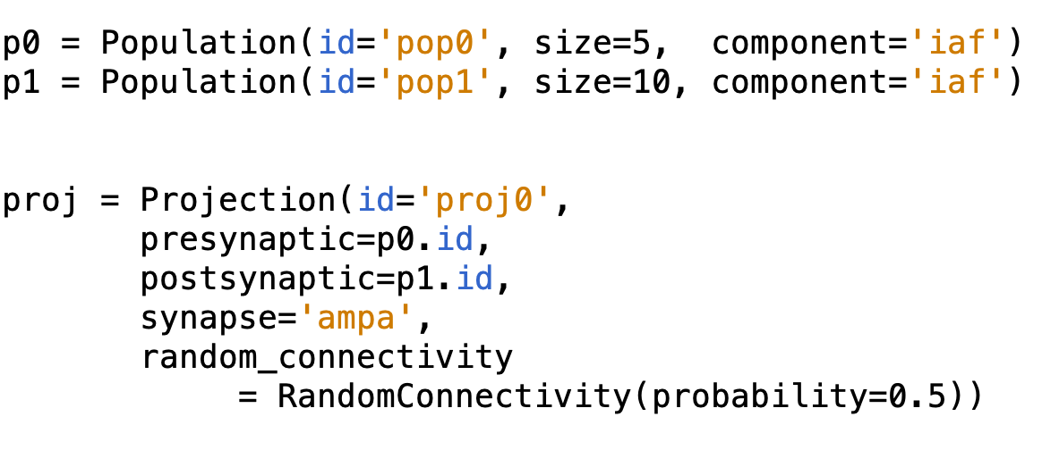
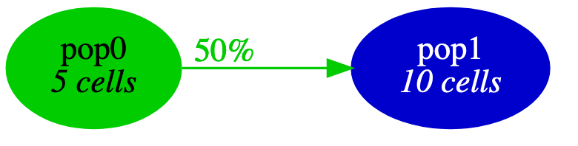
Notes:
8/17/17
10
10

Slide 11
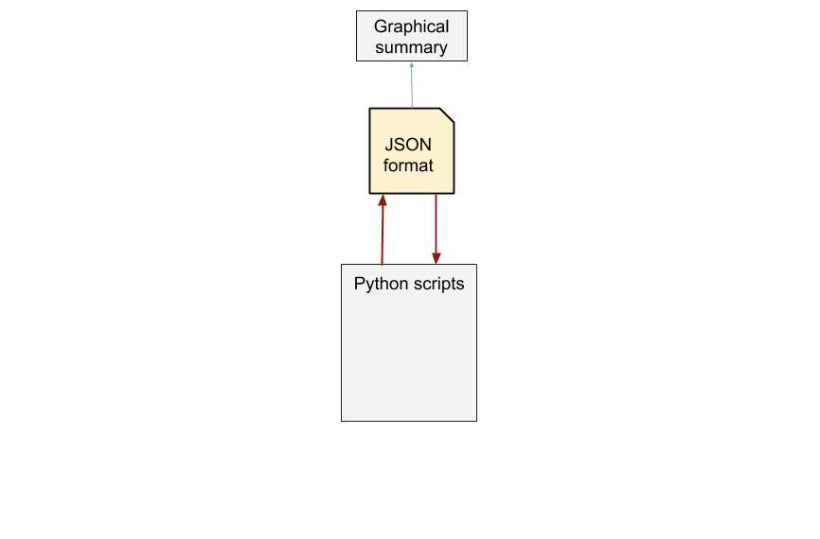
Notes:
8/17/17
11
11

Slide 12
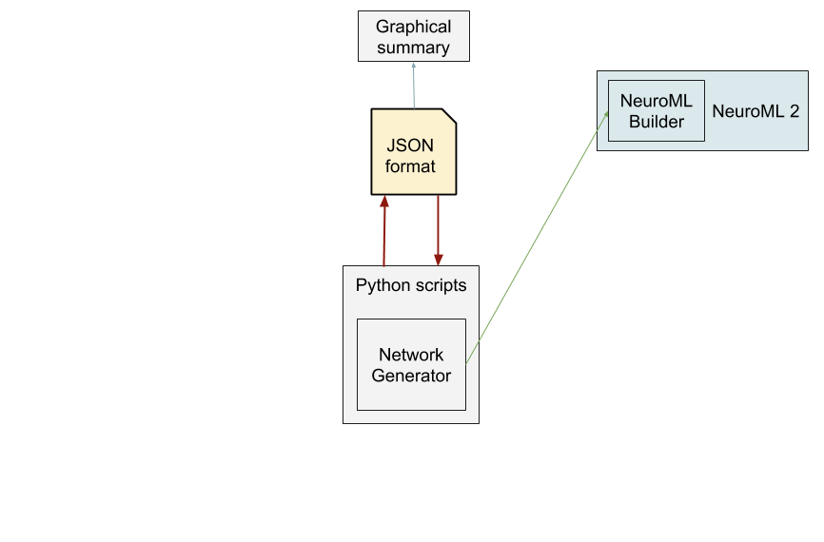
Notes:
8/17/17
12
12

Slide 13
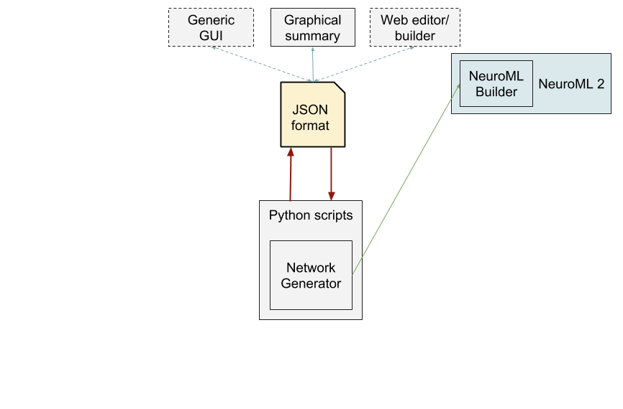
Notes:
8/17/17
13
13

Slide 14
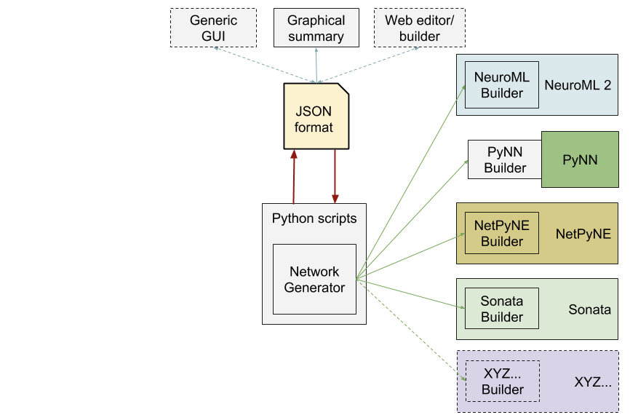
Notes:
8/17/17
14
14

Slide 15
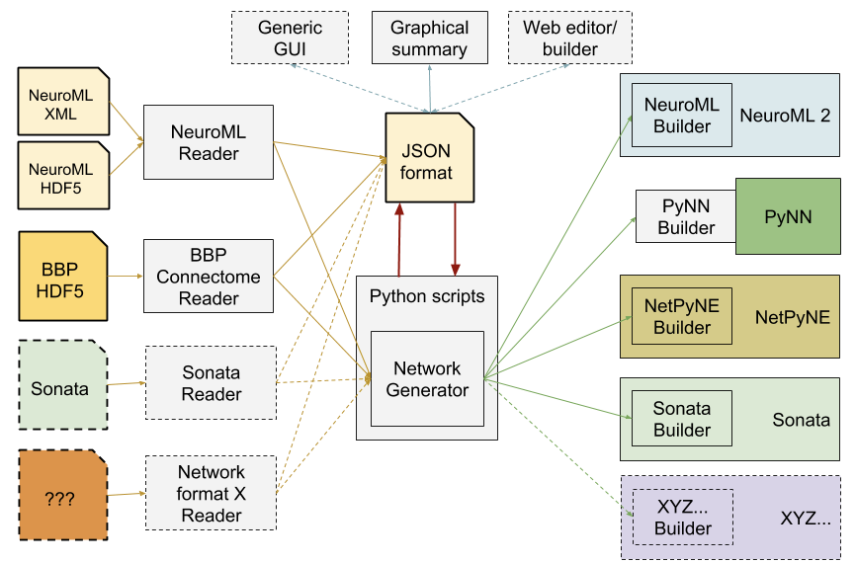
Notes:
8/17/17
15
15

Slide 16
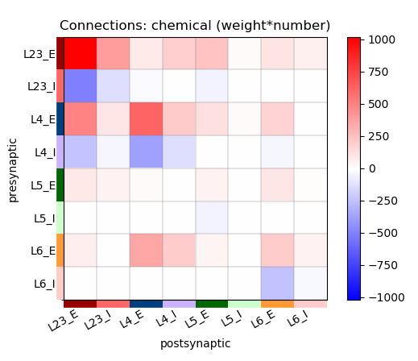
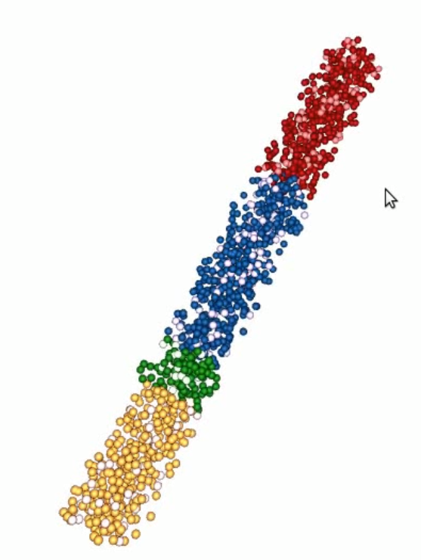
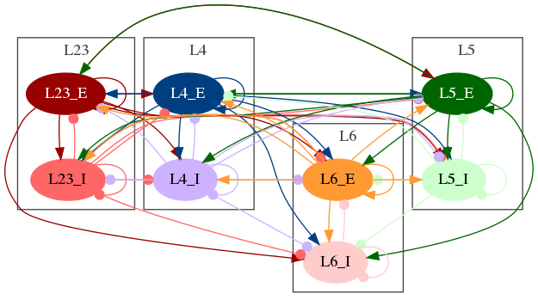
Notes:
8/17/17
16
16

Slide 17
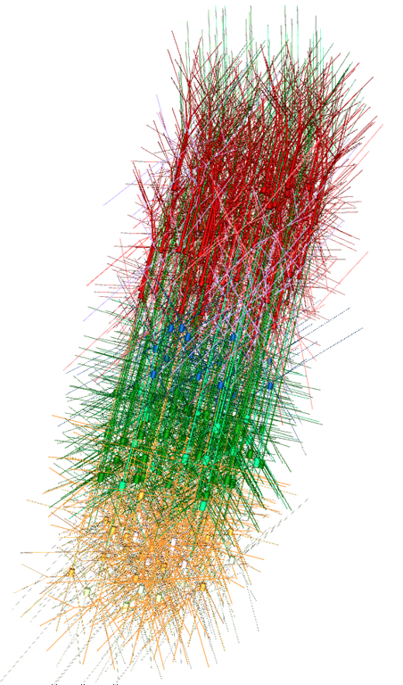
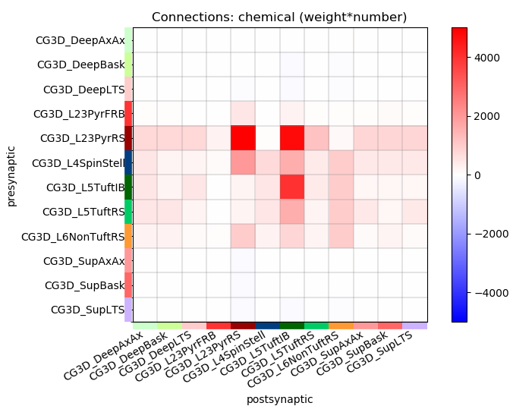
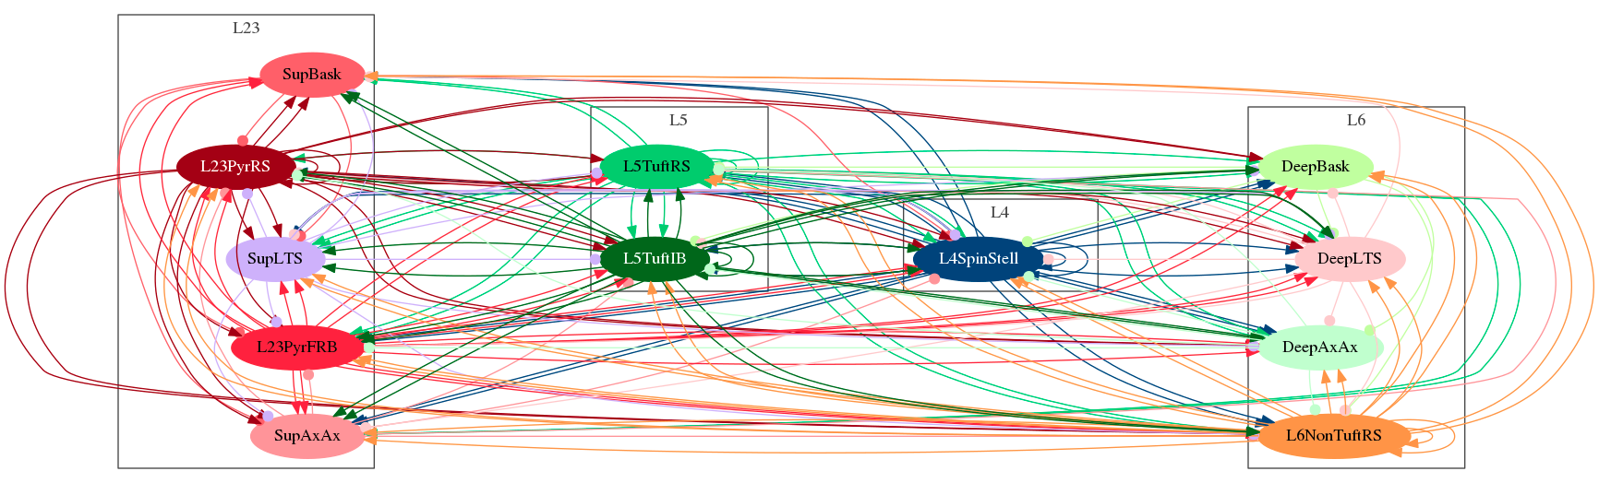
Notes:
8/17/17
17
17

Slide 18
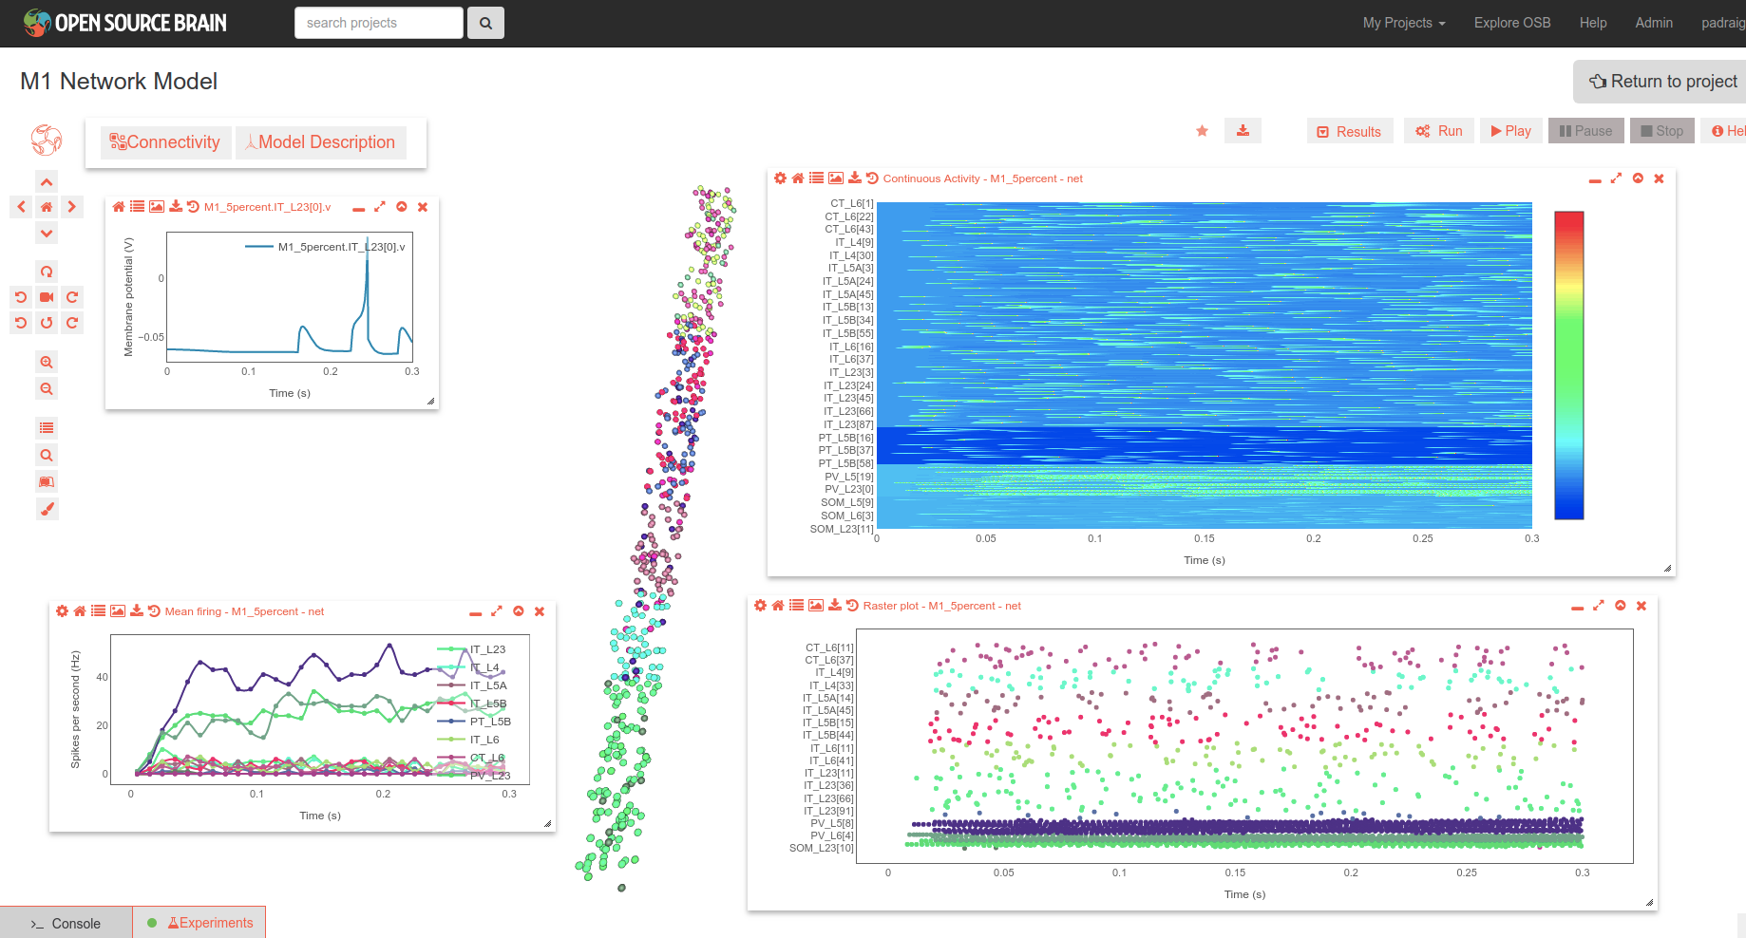
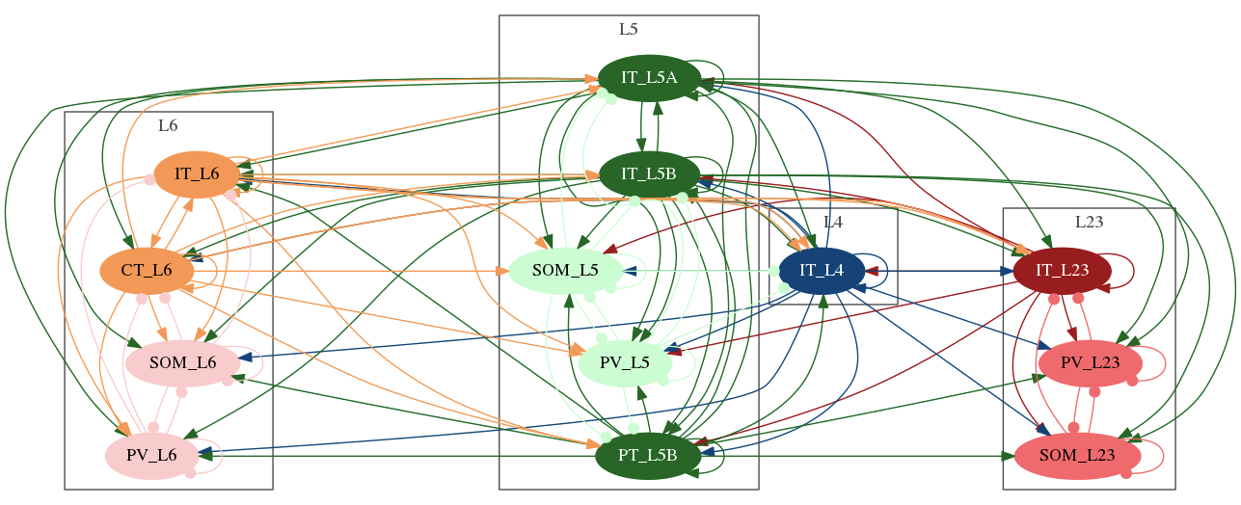

Slide 19
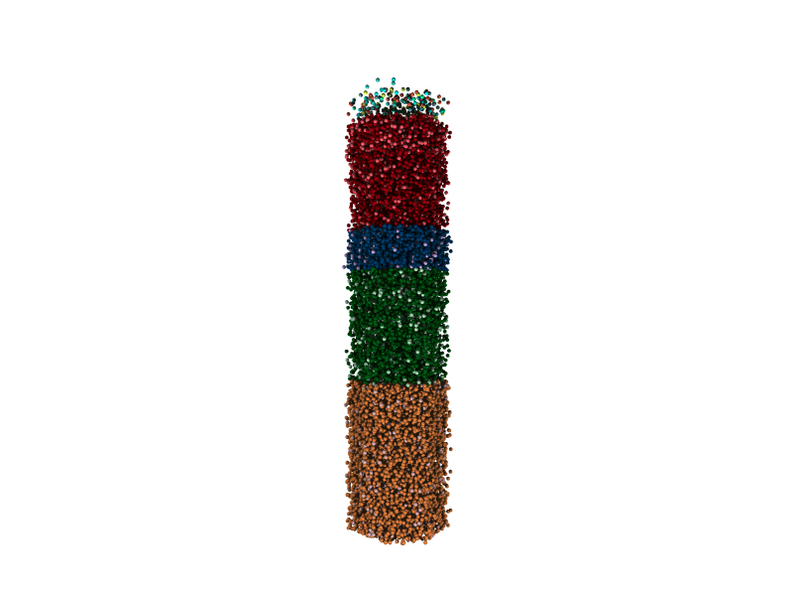
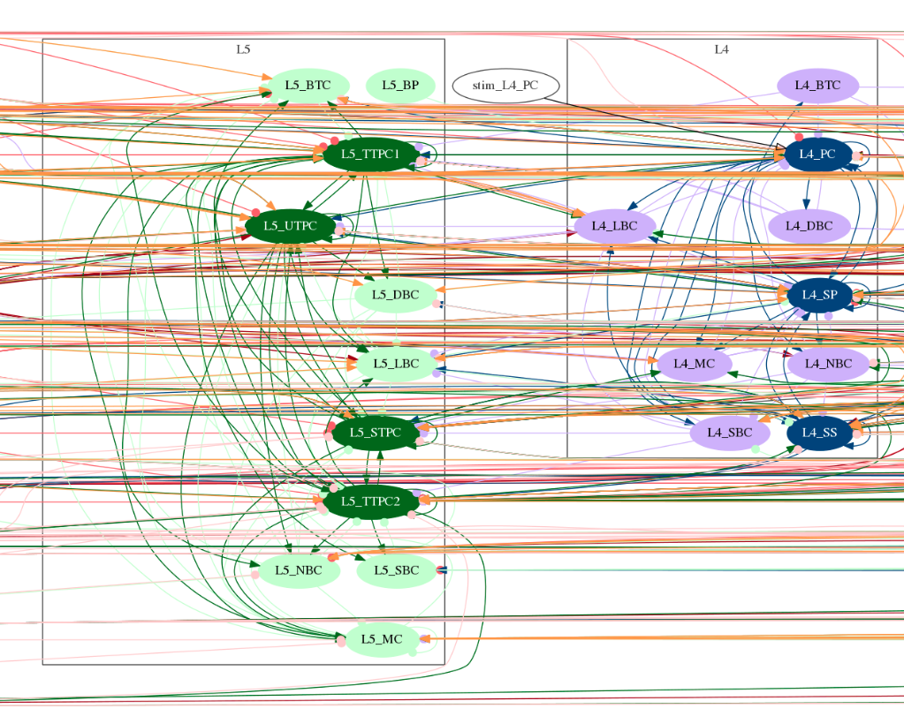
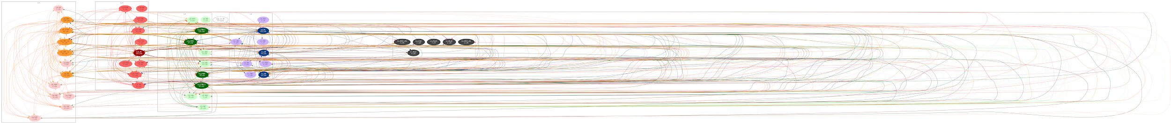
Notes:
8/17/17
19
19

Slide 20
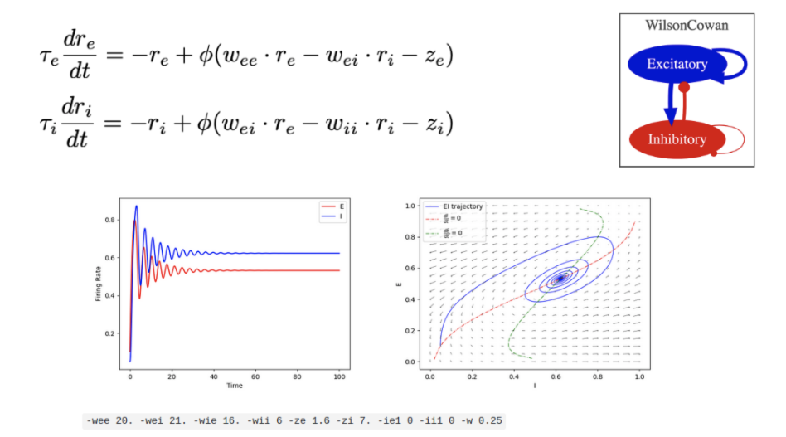
Wilson and Cowan – Excitatory and Inhibitory populations
Notes:
8/17/17
20
20

Slide 21
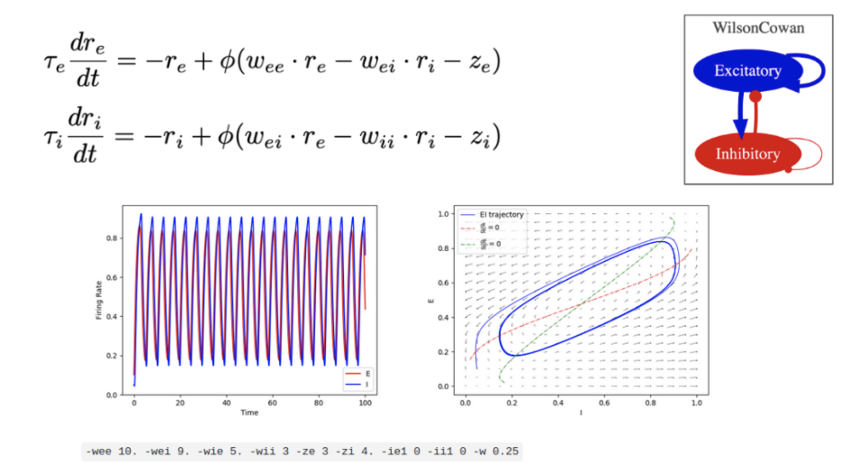
Wilson and Cowan – Excitatory and Inhibitory populations
Notes:
8/17/17
21
21

Slide 22
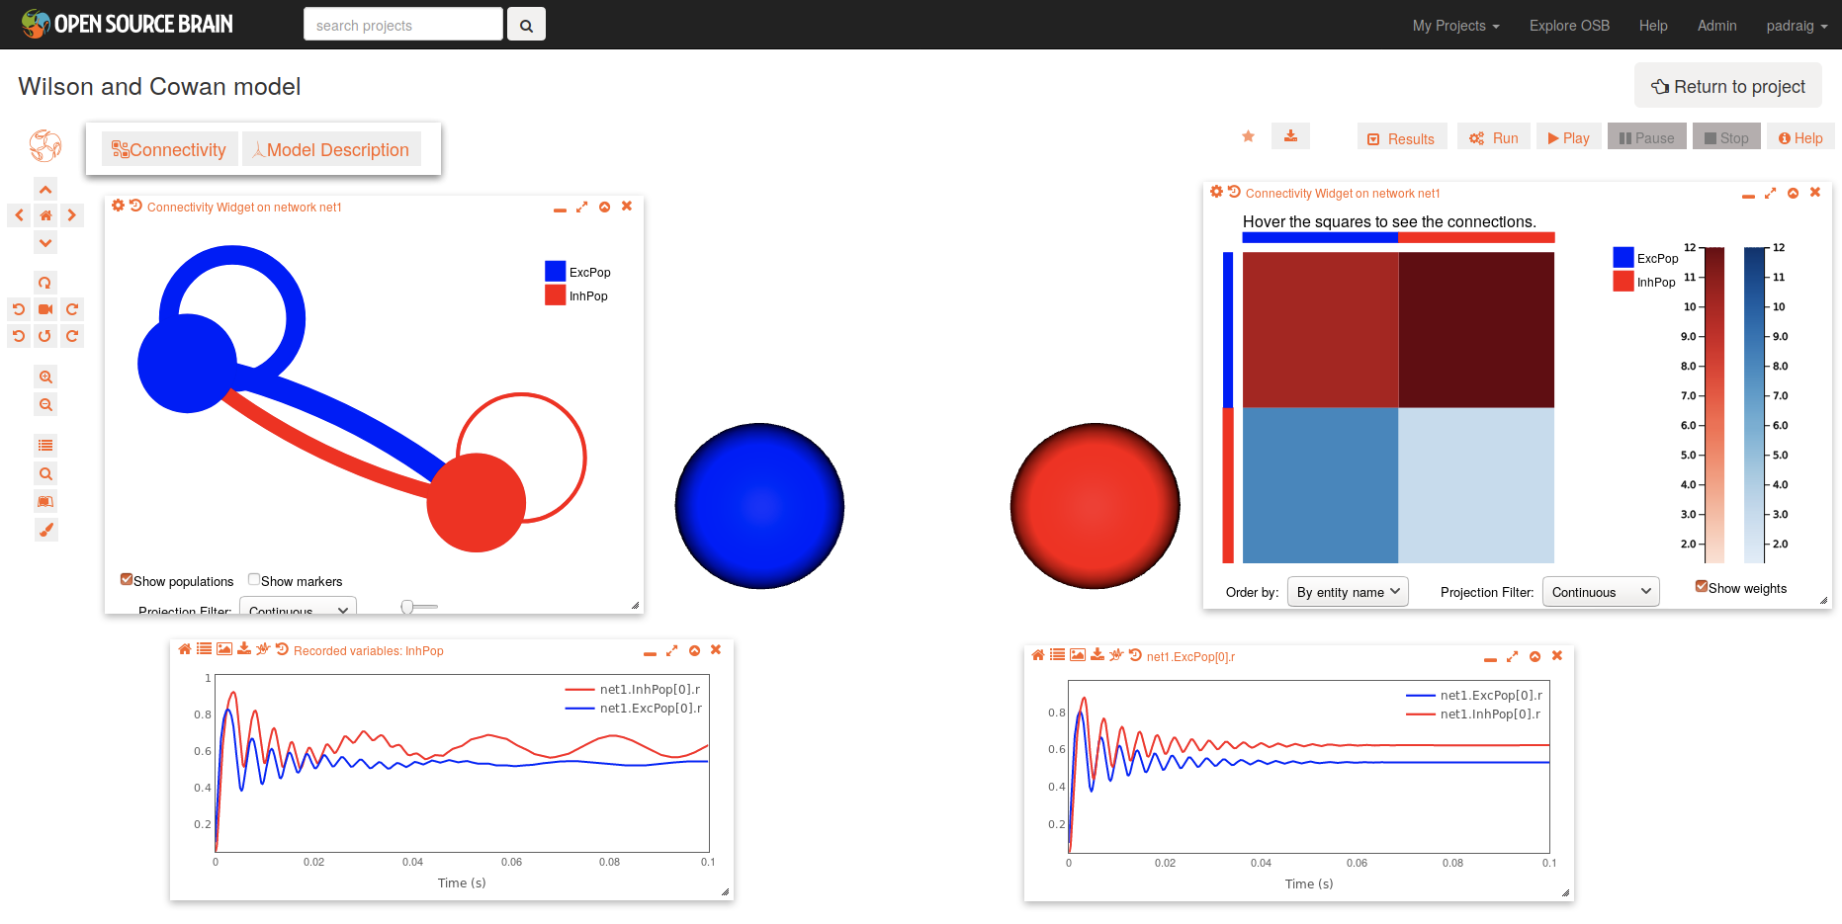
Wilson and Cowan – Excitatory and Inhibitory populations
Notes:
8/17/17
22
22

Slide 23
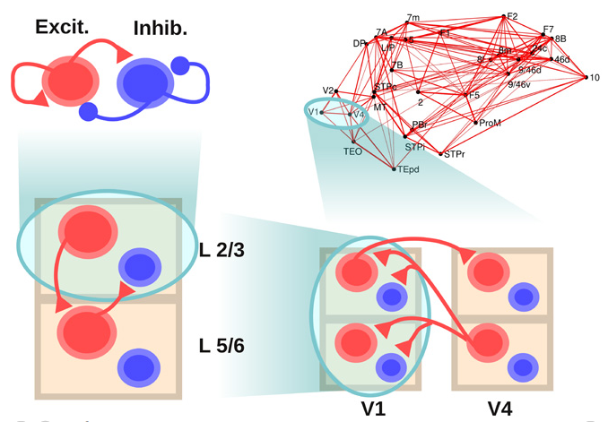
JF Mejias, JD Murray, H Kennedy, and X-J Wang, Feedforward and Feedback Frequency-Dependent Interactions in a Large-Scale Laminar Network of the Primate Cortex. Science Advances, 2016
Notes:
8/17/17
23
23

Slide 24
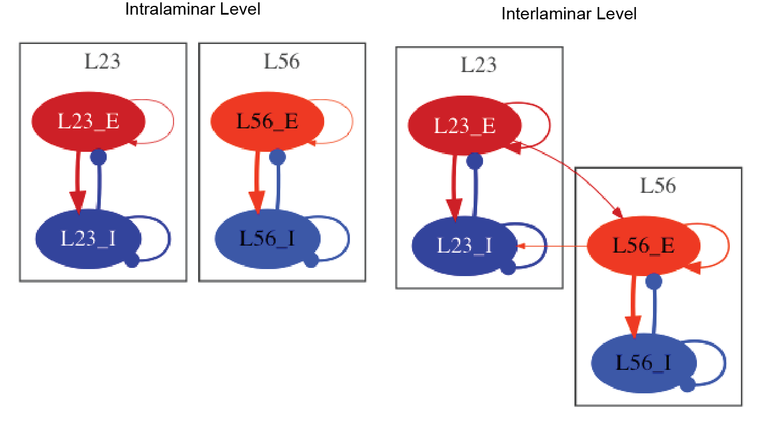
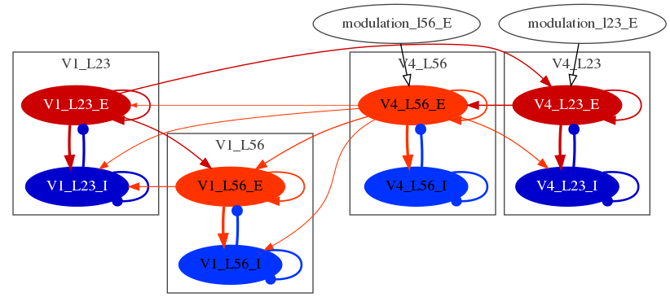
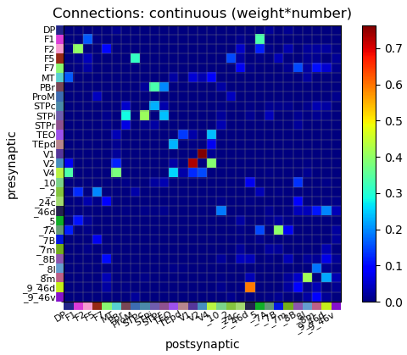
JF Mejias, JD Murray, H Kennedy, and X-J Wang, Feedforward and Feedback Frequency-Dependent Interactions in a Large-Scale Laminar Network of the Primate Cortex. Science Advances, 2016
Jessica Dafflon, Kings College
Google Summer of Code 2018
Notes:
8/17/17
24
24

Slide 25
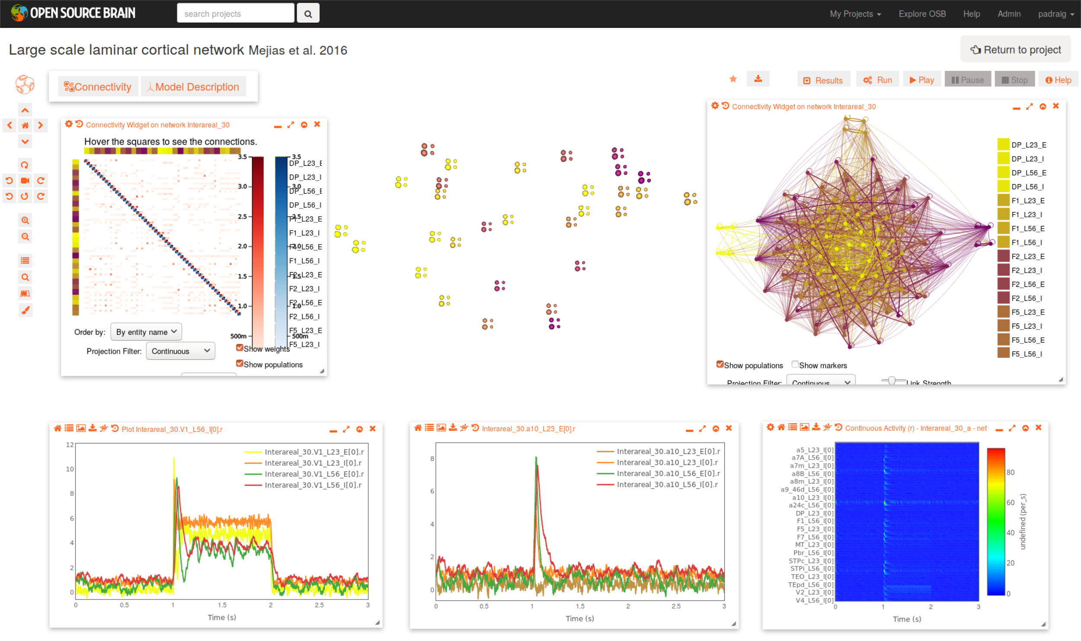
Notes:
8/17/17
25
25

Slide 26
A mesoscale connectome of the mouse brain, Oh et al.
Nature 2014

Slide 27
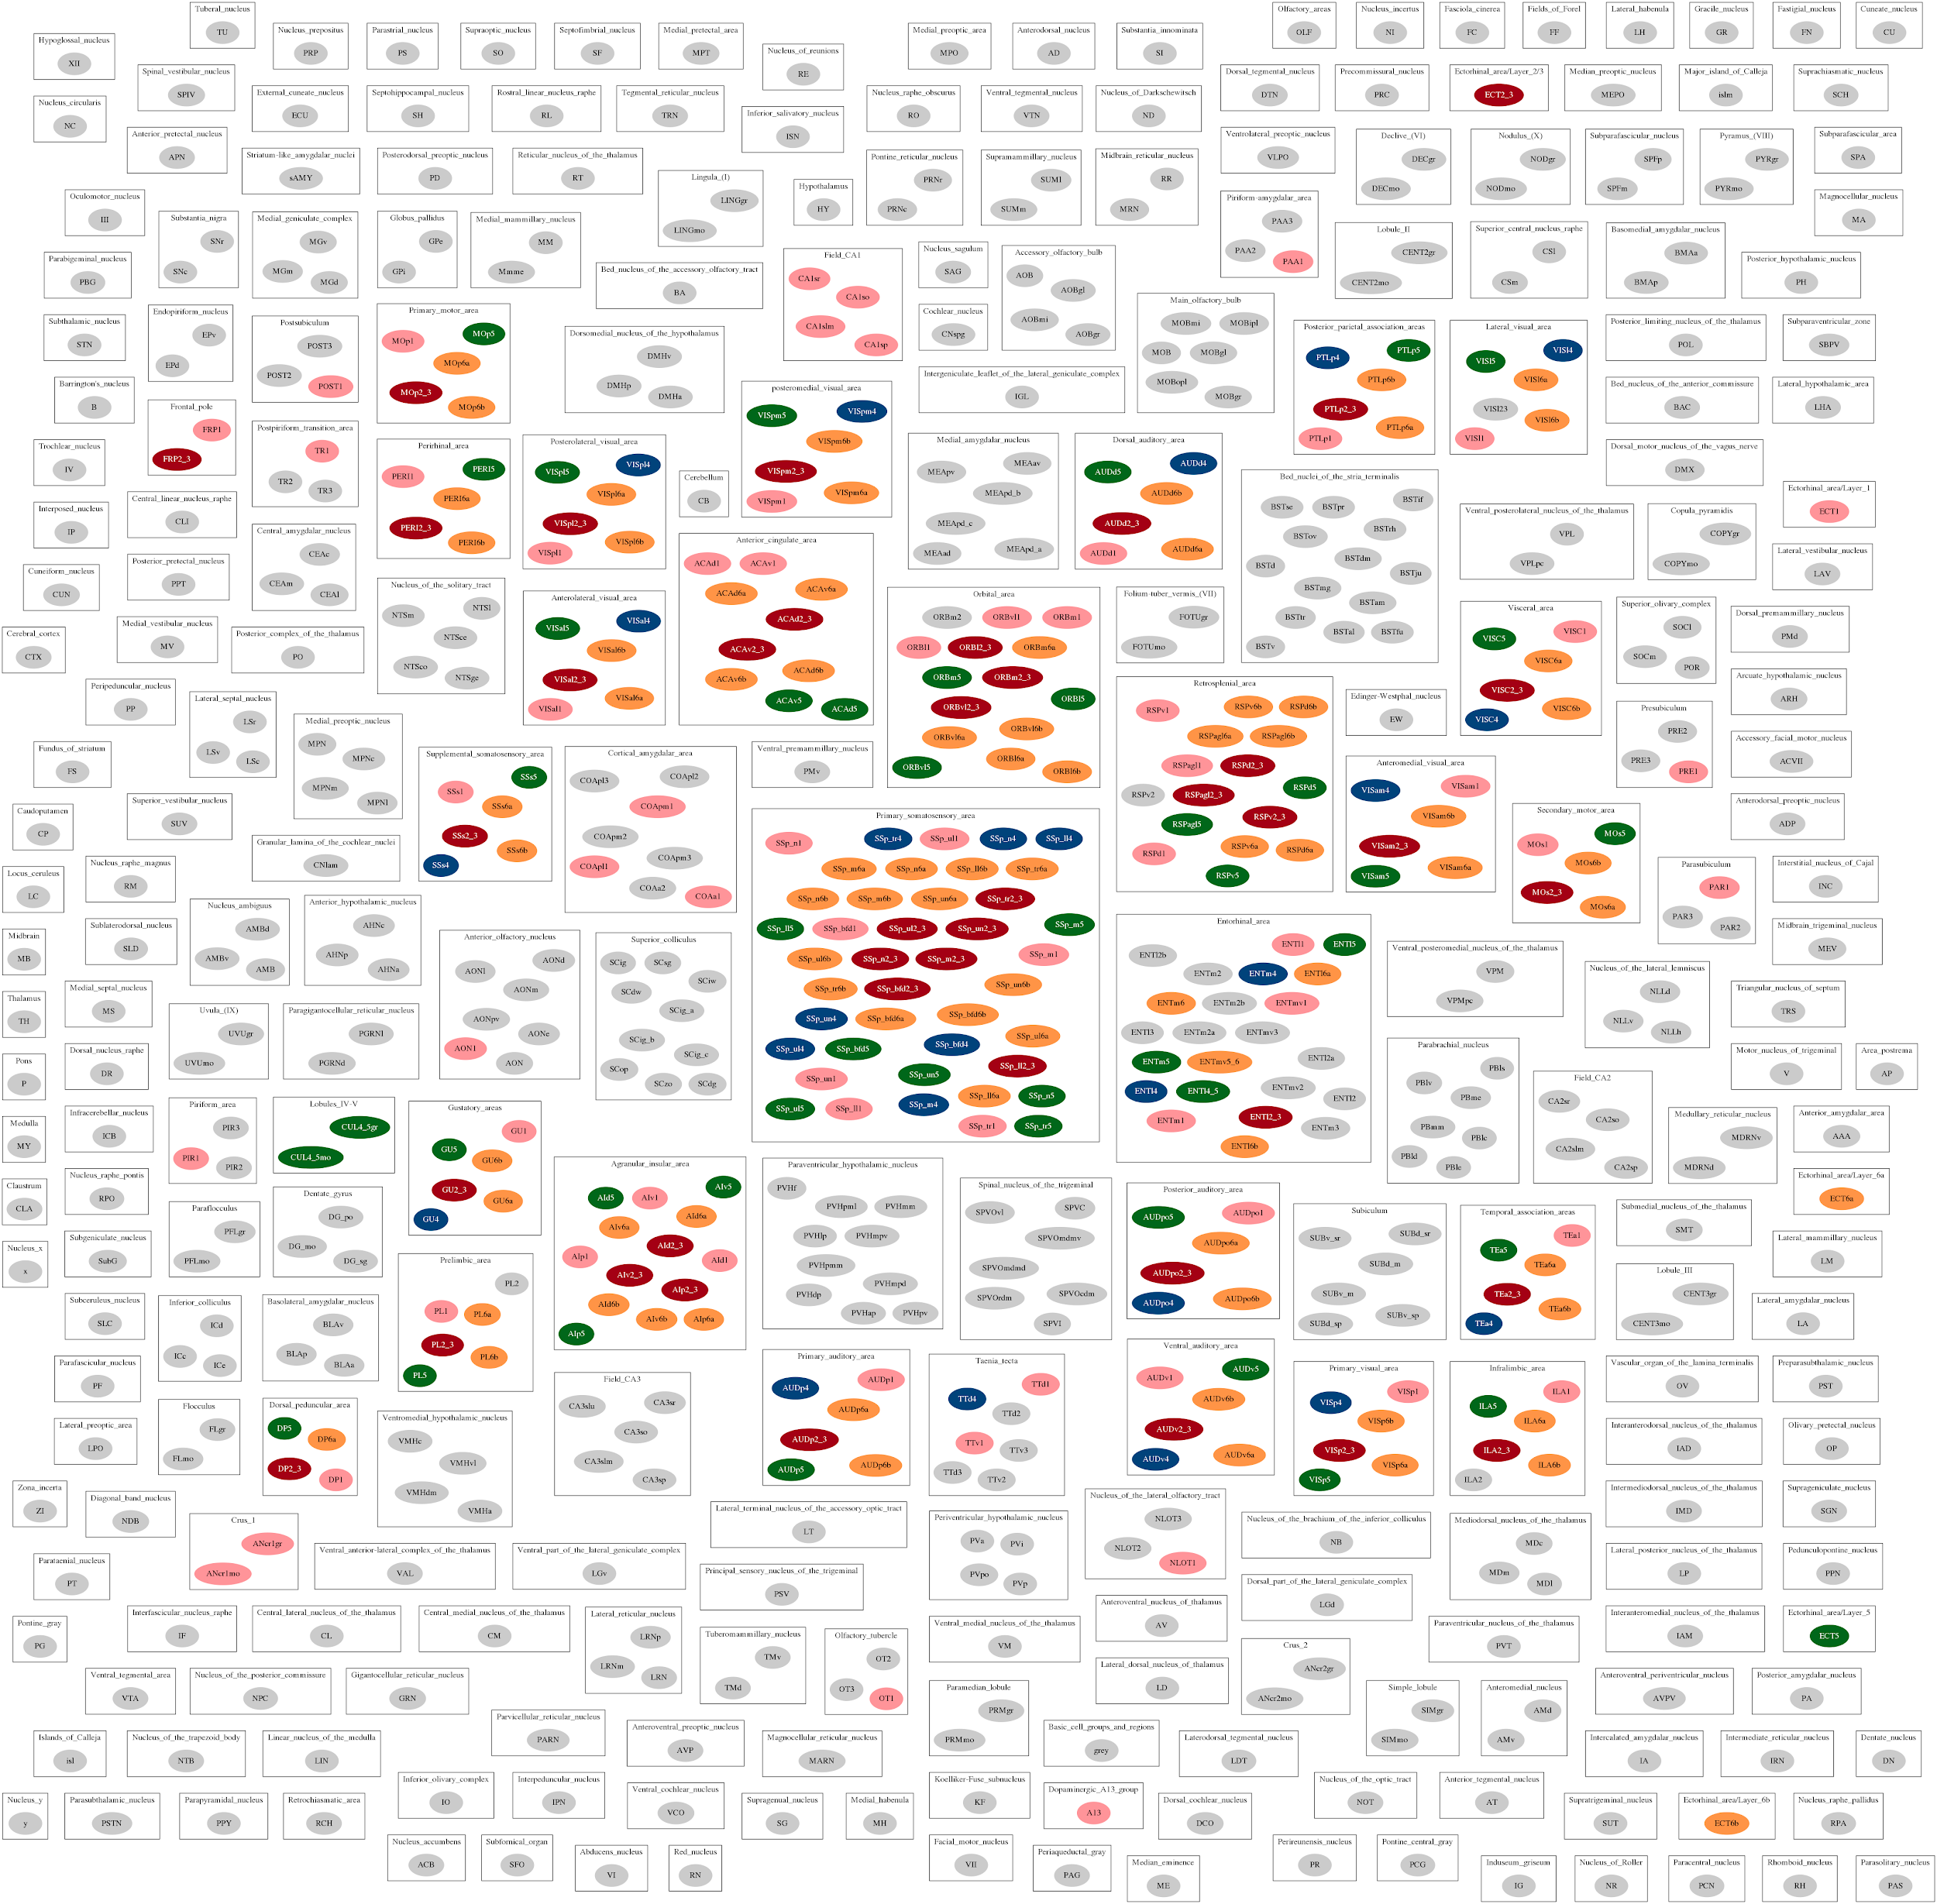

A mesoscale connectome of the mouse brain, Oh et al.
Nature 2014

Slide 28

Notes:
8/17/17
28
28

Slide 29

Notes:
8/17/17
29
29

Slide 30

Notes:
8/17/17
30
30

Slide 31

Notes:
8/17/17
31
31

Slide 32

Notes:
8/17/17
32
32

Slide 33

Notes:
8/17/17
33
33

Slide 34









Acknowledgements
Silver Lab @ UCL
Angus Silver
Matt Earnshaw
Sadra Sadeh
Alex Cayco-Gajic
Eugenio Piasini
Boris Marin
Adrian Quintana
Matteo Farinella
Yates Buckley
Rokas Stanislovas
Andras Ecker
Matteo Cantarelli (MetaCell)
Collaborators
Robert Cannon
Sharon Crook
Jessica Dafflon
Sergio Solinas
Volker Steuber
Dieter Jaeger
Andrew Davison
Stephen Larson
Avrama Blackwell
Members of the NeuroML community
OpenWorm project MetaCell
Coordinating initiatives
Funding sources
Notes:
8/17/17
34
34

